Slide 1




Global Online Series “Building Back Better: Green, Healthy and Inclusive Cities”
Hosted by the Global Platform for Sustainable Cities
Resilient Waste Management:
Addressing Challenges during COVID
WASTE, RECYCLING, COVID-19 SITUATION IN ARGENTINA
Ing. Marcelo E. Rosso
New Technologies and Environmental Control Manager

Slide 2
GENERAL INTEGRATED MUNICIPAL SOLID WASTE MANAGEMENT SITUATION IN ARGENTINA PREVIOUS TO COVID-19
Current population of about 45,000,000
Over 90% of population concentrated in urban sectors
Household Waste collection reaches over 99.8% of the population and it is carried out in different ways according to the city size and its available funds; 54% is privately managed and 46% through direct municipal management; 70% of the collection is performed daily
Insufficient economic resources
Lack of unified statistics.
TONS OF RSU MANAGED BY CEAMSE 2020
FINAL DISPOSAL MODALITY IN ARGENTINA
General Pueyrredón Municipality 6%
35% Open
dumps
47% Managed by CEAMSE
Total CABA 31%
18% Final disposal
49 Municipalities of the Province of Buenos Aires 63%

Slide 3
GENERAL INTEGRATED MUNICIPAL SOLID WASTE MANAGEMENT SITUATION IN ARGENTINA DURING COVID-19
The urban solid waste management was considered an essential activity and the service was rendered on an almost normal basis during the lockdown period in the Metropolitan Area of Buenos Aires (234 days)
Safety measures for the staff where adopted, such as personal protection elements, alcohol in vehicles and working places, cabin cleansing, use of mouth protection, sanitization cabins, social distancing, mats for the cleaning of shoes when entering buildings, scheduled desinfection, etc.
Collection, Transport, Transference, Treatment, and Final Disposal are being performed on a normal basis.
Some of the routes of container collection have been optimized based on their capacity, which allowed for new routes of sanitization or cleansing to be developed.
The staff was reduced by 15% since due to the age and pre-existing conditions, such as diabetes, obesity, etc.
The members of the staff working with collection trucks leave at different hours in order to avoid close contact.

Slide 4
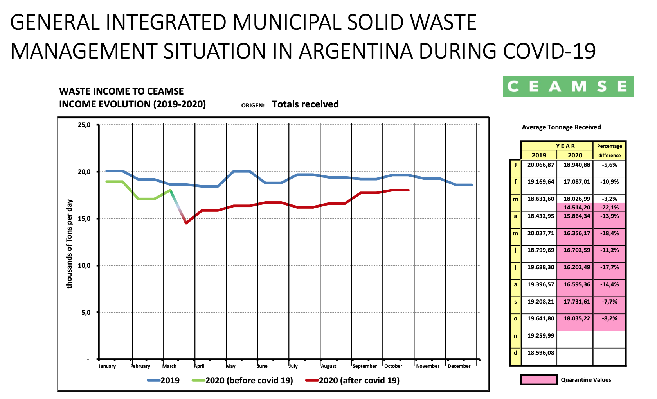

Slide 5
GENERAL SITUATION OF HEALTH CARE WASTE IN ARGENTINA
There are 26 facilities for the Health Care Waste treatment in the country, out of which those with a greater capacity are in the Province of Buenos Aires.
When starting with the lockdown, the authorities feared the system to be under stress
Taking the Province of Buenos Aires as a leading case, it can be deducted that health care waste generation is between 2 and 3 kg/bed/day.
During the first days of the pandemic, health care waste was reduced in approximately 20% due to a lower quantity of patients per outpatient unit and a lower specific weight (higher quantity of material of disposable protection).
Difficulties in logistics in order to perform collection (more volume and less weight), and a reduced number of staff due to emergency schedules.
As from August and September there was an increase of about 30% in quantity above the normal levels due to a higher beds occupancy; medical practice and standard internmet were resumed.

Slide 6
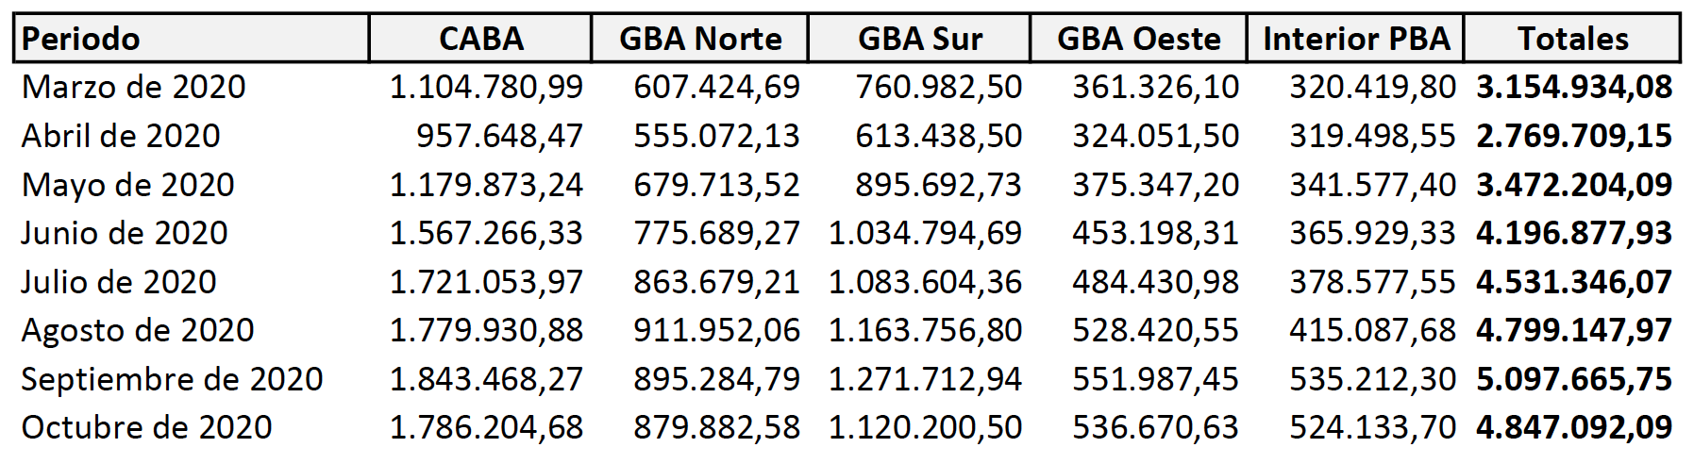
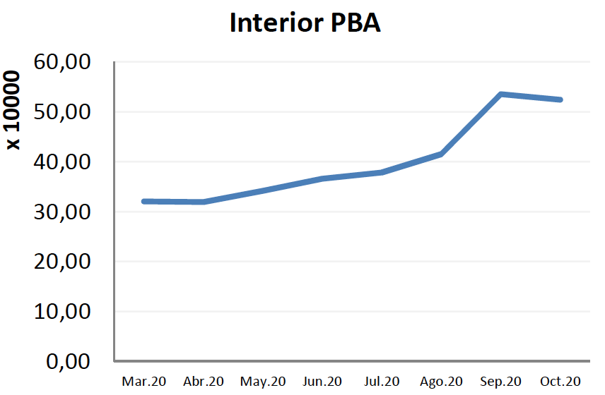
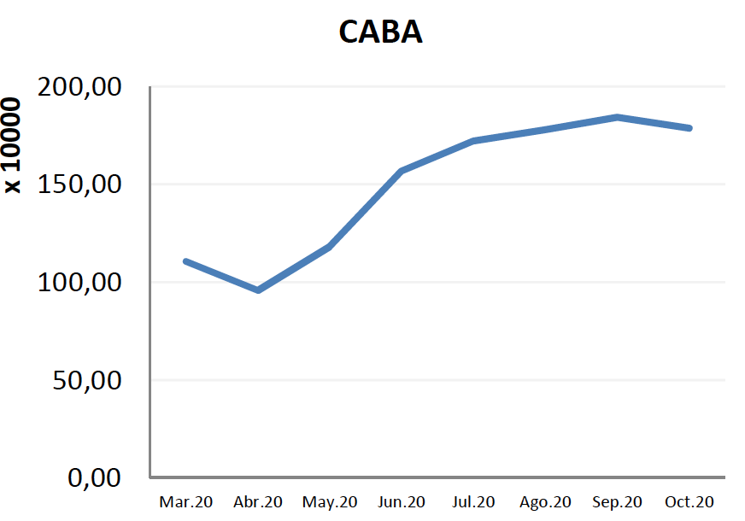
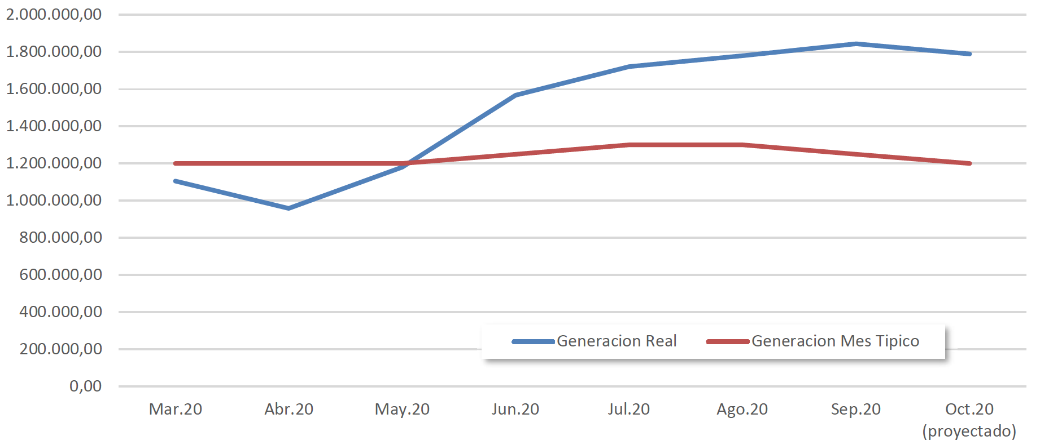
GENERAL SITUATION OF HEALTH CARE WASTE IN CABA - ARGENTINA
Fuente: Camara Argentina de Industrias de Tratamiento para la Protección Ambiental

Slide 7
SITUATION OF SORTING AND RECYCLING OF URBAN SOLID WASTE IN ARGENTINA DURING COVID-19
Sorting facilities operated by NGO’s as well as the activity of the informal collection workers came to a halt at the beginning of the compulsory lockdown.
Afterwards, in the Province of Buenos Aires (May) for instance, under Res. 213/2020: “Approve the reccomendations and measures of prevention aimed to protect the health of workers of waste recovery and recycling area according to protocol (Waste treatment – Material sorting – Workers protection – Protection elements – Recomendations for Treatment Facilities). Coronavirus COVID-19-Pandemic (OPDS)”.
In May the activity was of approximately 15%; nowadays it is of about 45% and it is being adjusted according to the epidemiologic situation.

Slide 8
SITUATION OF SORTING AND RECYCLING OF URBAN SOLID WASTE IN ARGENTINA DURING COVID-19
Before the lockdown in the Capital City of Buenos Aires (CABA), in the 16 (sixteen) Green Centers operated by official NGO´s within the IMSWM, about 5,000 tons/month of dry materials coming from recycling collection were processed.
As from March 19th, the activity was interrupted and the processed quantity was reduced by a half.
In April and May there was no activity. As from that moment, some centres started receiving materials and currently they are operating 2 or 3 times a week, fulfilling strict protocols and with reduced schedules.
Currently, 2,000 tons/month are being processed.

Slide 9
SITUATION OF SORTING AND RECYCLING OF URBAN
SOLID WASTE IN ARGENTINA DURING COVID-19
Mechanical Biological Treatment Facilities of CEAMSE operate without manual sorting and the staff is divided in groups.
The main recycling companies were working at 20% capacity and currently, at 35% due to the lack of material.
Gatherers are closed in most of the cases.
Decrease in the oil price has a direct impact in the activity.
The facility of waste Construction and Demolition in CABA was closed until May (the construction industry was practically at a halt until the lockdown was released).

Slide 10
WHAT ARE THE MAJOR CHALLENGES TO BE FACED IN THIS SITUATION/LEARNING/FUTURE OPPORTUNITIES?
Availability of economic resources in a post pandemic economy with restrictions.
Staff training to maintain protection
Automatize, if possible, waste management systems (collection, recycling, treatment) in order to avoid personal contact and reduce the possibility of disease transmission.
Reconsider informal collection, as part of the waste management. Informal implies with no controls. No controls implies problems in this type of emergencies.
Real analysis of the advantages of waste-to-energy (W2E) taking into account that in this way all pathogenic waste are definitely eliminated.

Slide 11
THANK YOU VERY MUCH
Ing. Marcelo E. Rosso
CEAMSE
New Technologies and Environmental Control Manager
mrosso@ceamse.gov.ar
marcelo.rosso@gmail.com

