Slide 1
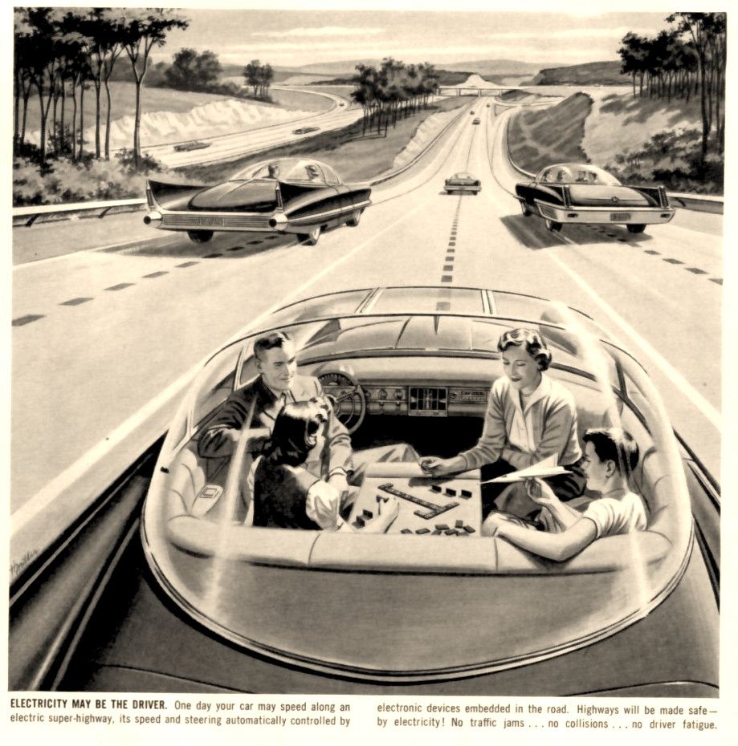
Urban Form and Automated Flows
The Prospect of Automation in Transportation for Future City Form
Tanvi Maheshwari
Advertisement of driverless car in 1957. Paleofuture.com
Notes:
Today I have been asked to speak about what the advent of autonomous vehicles means for the future city. I am an urban designer by training with special interest in street design, so this question deeply interests me. We are all well aware thatt the idea of ‘driverless car’ has been around for a long time, like this ad from 1957 of a driverless car.

Slide 2
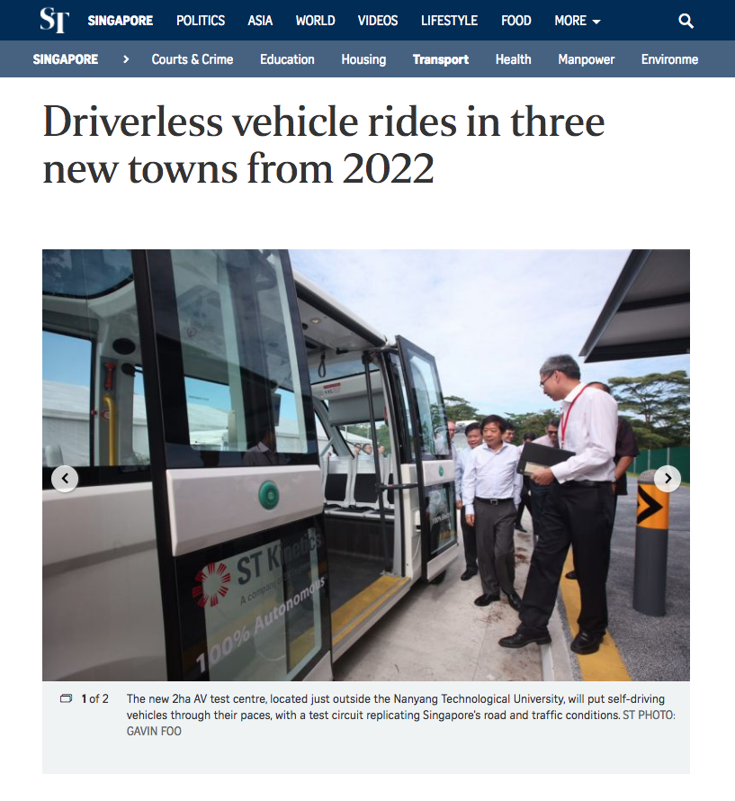
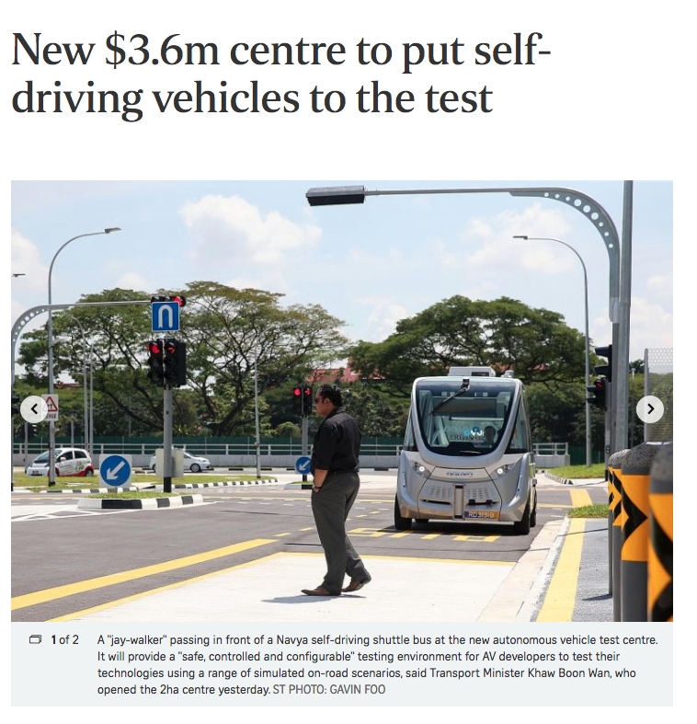
Driverless Vehicles in Singapore
Notes:
But today the ‘autonomous vehicle’ is viewed as a disruption, not a fantastic futuristic idea. These are images from recent tests and press releases on driverless vehicles in Singapore. Certain technologies required to make AVs economically and technically viable have matured enough to make them a reality, even if in the distant future. Relevant for planners since we are supposed to be thinking about distant future.

Slide 3
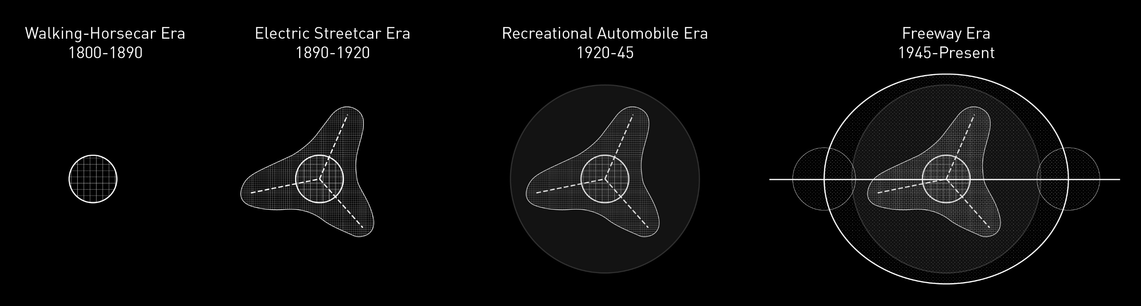
Diagram adapted from Peter O. Muller’s Transportation and Urban Form
Driverless Vehicles in Singapore
Notes:
We have seen through history how innovations in transport technology can have profound impacts on the form of the city. This means we have to seriously start considering their impact on cities and urban form. But it’s not just the impact but also the INTENT. Intentional policy and planning moves - What and how we are thinking about this future city for AVs is very critical.

Slide 4
Notes:
Let’s go back to the this image from 1957. The possibilities of the private automobile seemed endless, people were very optimistic about the benefits of mass automobilisation as this image shows.

Slide 5
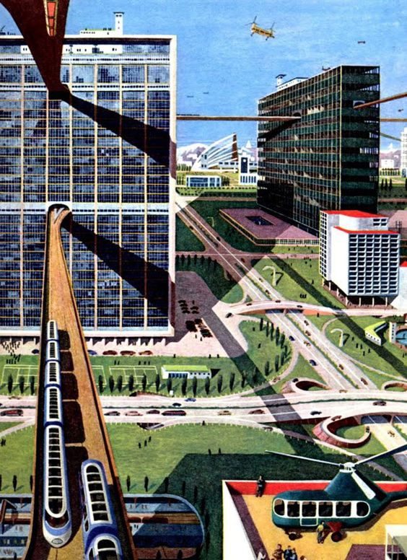
Notes:
At the same time, we saw these types of images appear, that imagined how cities to harness all these benefits, and realise its full potential. This is a contemporaneous image to the image on the right. Let me unpack some of it’s features to illustrate my point.

Slide 6
Segregation by mode for efficiency
Use of vertical space in anticipation of future land scarcity
Convenience of door to door service
Non-machines separated or eliminated
Individualized car based transportation
Image from 1950 educational books via monodrama2000 and Rainbow mermain
Notes:
Let me unpack this image from a 1950s education book.
[CLICK1]
Here we see a bias for personal transportation
[CLICK2]
A dis-regard for non-machines, that are either segregated or not even visualized
[CLICK3]
A penchant for convenience of door-to-door service
[CLICK4]
And spatial segregation by travel mode, generously utilizing the vertical space, perhaps in anticipation of future land scarcity in car dependent cities.
[CLICK5]
Drawings at that time invariably showed the skies dotted with flying machines. 2000 A.D. has come and gone, but flying cars never took off. However, with the hindsight of some 50 years, it is not difficult to see how many of these ideas have materialized in today’s car-oriented urban developments. As we gear up for automated vehicles to hit the road, it is crucial we look beyond the technology and critically examine how it will impact our cities, because the impacts are not straightforward.

Slide 7
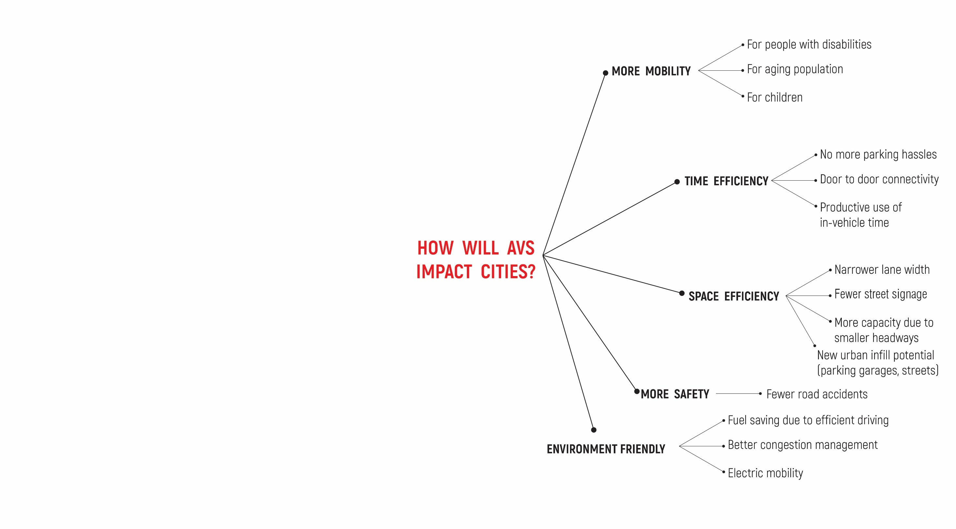
Notes:
There is a strong narrative by advocates of AV tech about the many benefits of AVs. They mainly fall in 5 categories – AVs are expected to offer more mobility, time efficiency, space efficiency, environmental sustainability and safety.

Slide 8
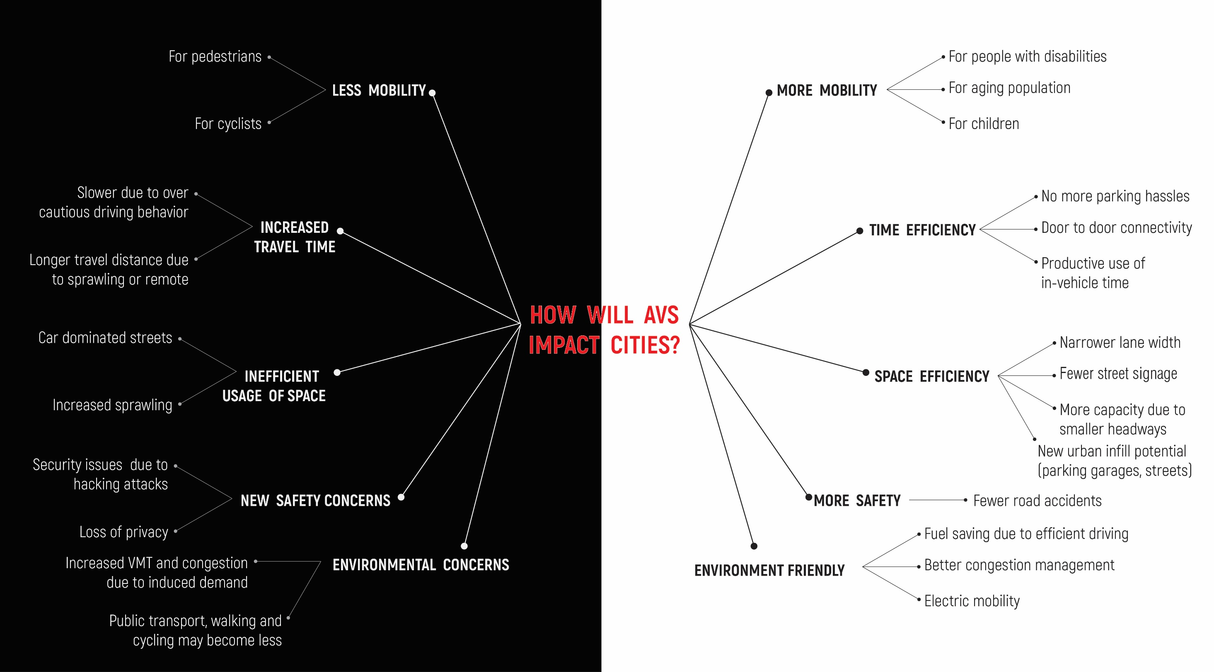
Notes:
At the same time it is important to recognize, that there is a certain circularity in these benefits that easily translates in potential dangers. Additionally these benefits are based on some inherent assumptions about policy and implementation, which may not necessarily be true. So it’s clear that we cannot take these benefits (or dangers) at face value and need to critically examine how AVs impact transport flows and form.

Slide 9
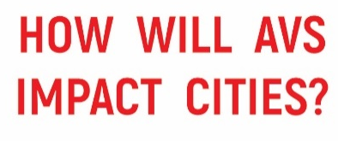
How will AVs impact transport flows?
Notes:
First, it is important to understand the implications of automation on travel behaviour an transport flows.
Unprecedented level of comfort due to autonomy, ungluing of transport flows from infrastructure, electrification, shared economy, internet of things.

Slide 10


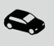
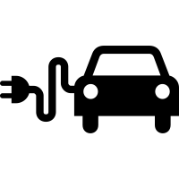
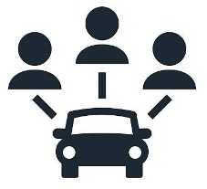

How will AVs impact transport flows?
Unprecedented level of comfort and easy of personal mobility will be possible with autonomy
Automation will enable ‘ungluing’ of transport flows from infrastructure.
Rise of car sharing and end of personal vehicle ownership is enabled by AVs
Electrification of vehicles will be supported by AVs
‘Internet of Things’ will boost the viability of AVs, and help to consolidate transport flows into one integrated connected system
Notes:
First, it is important to understand the implications of automation on travel behaviour an transport flows.
Unprecedented level of comfort due to autonomy, ungluing of transport flows from infrastructure, electrification, shared economy, internet of things.

Slide 11
How do we reimagine city form in response to this?
Notes:
First, it is important to understand the implications of automation on travel behaviour an transport flows.
Unprecedented level of comfort due to autonomy, ungluing of transport flows from infrastructure, electrification, shared economy, internet of things.

Slide 12
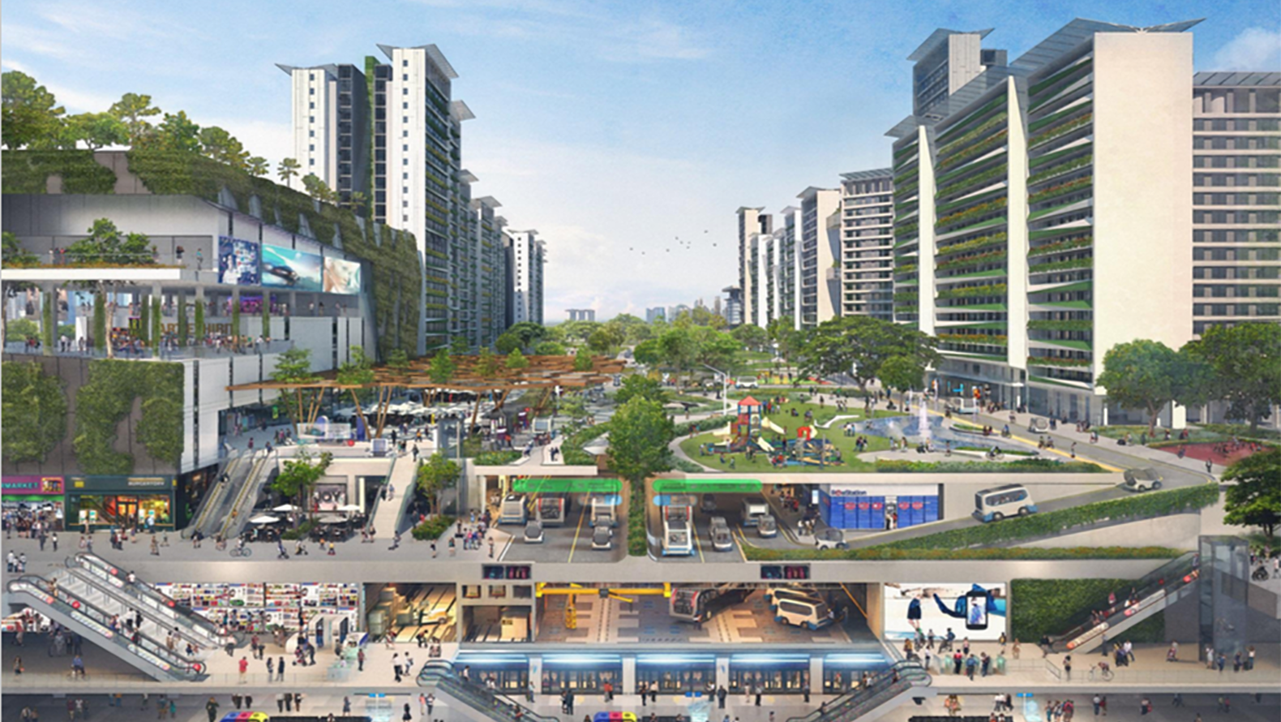
AV ≠ Car - Driver
Concept of a future town centre in Singapore with autonomous Vehicles. (Source: Ministry of Transport)
Notes:
This is Singapore MoT visionary image for AVs. Segregation by levels is a strategy that was employed for car based urbanism as well. But AV is not a car minus driver, as discussed before. So the possibilities of this suite of new systems and technologies should reflect in our vision for the future.

Slide 13
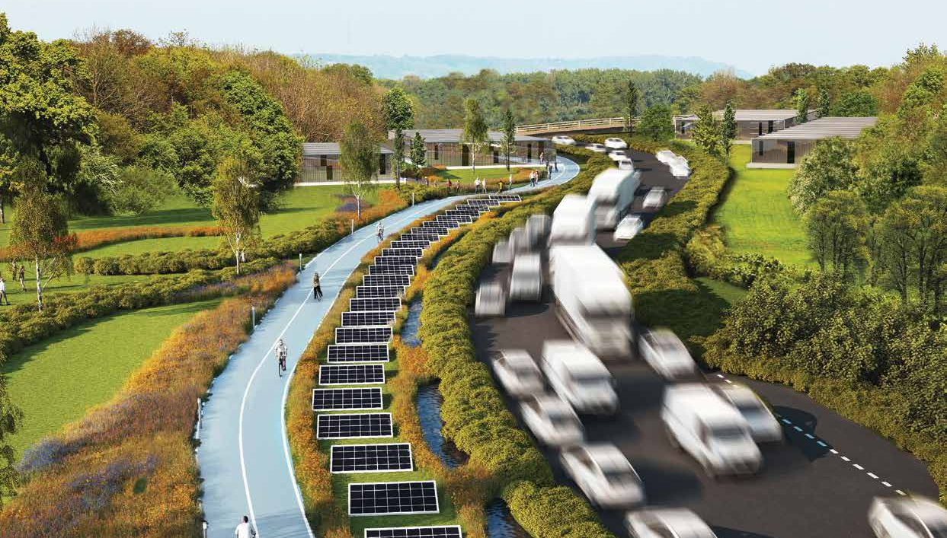
Context Specific Urban Design Strategies and Operational Paradigms
From WSP Parsons Brinckerhoff Farrels 2016
Notes:
It is important to undertand the context

Slide 14
What is the existing urban form?
Network Topology?
Land Use Distribution?
Development Intensity?
Street Profile?

Slide 15
What is the existing urban form?
Network Topology?
Land Use Distribution?
Development Intensity?
Street Profile?
What is the operational mode?
Private, enterprise or government dominated?
Size and mix of fleet?
Mode of access: Street hailing or pre-booking or both ?
Primarily use for last mile or full trip?
Parking at remote location or ‘roam in system’?
Notes:
What type of flows do we imagine for the future? Operational mode (private of govt managed)? Size of fleet (small vehicles or large)? Street hailing or pre-booking? Last mile vehicle or full trip? Park at remote location or roam in system?

Slide 16
Public
Taxi and Ridesharing Model
Eg. Uber
Govt. Regulated Fleet
Fully integrated ticketing and management with all public transport modes. Centralized Planning leads to more control over mode share.
Administrative burden, political implications.
No one needs to own a car! Just hail a ride. Danger of oligopoly/ monopoly by taxi companies. More VMT and Instability in service provision
Laissez Faire
Structured
Type of AV Policies
Personal Ownership Model
Eg. American Model
Demand Management Model
Car owners can now choose between human driven or autonomous cars with various levels of automation. You can choose to drive or choose to work while you are being driven. Car ownership becomes even more attractive
AVs are all subject to demand management regulations and operate in restricted areas. In this way the government indirectly manages mode share
Private
Operating Mode
Notes:
For example for Singapore we developed this matrix. But the system cannot be addressed in isolation. Context specific solutionsFor Singapore – top right of the quadrant. Type of network configuration? Density? Land use mix? Designed parking, street profiles, interface…

Slide 17
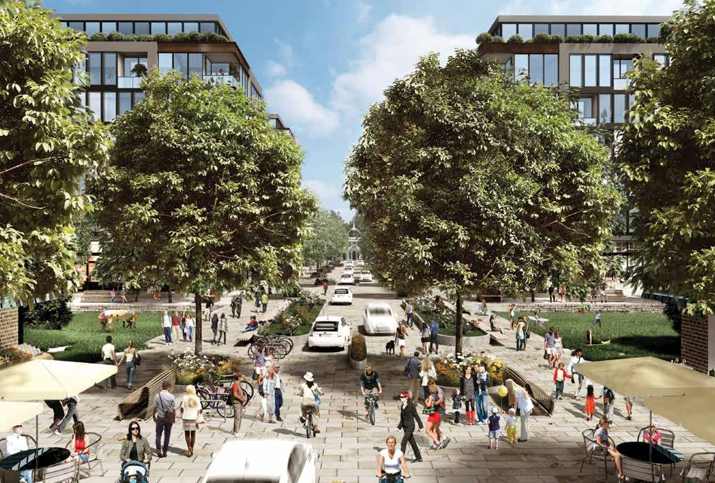
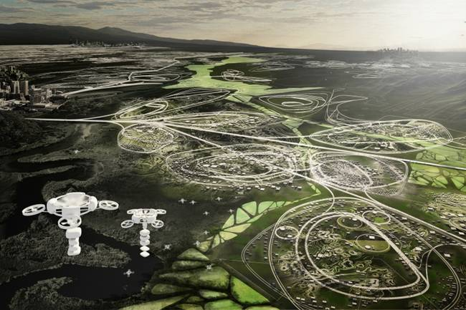
Is it a heaven or hell scenario?
From WSP Parsons Brinckerhoff Farrels 2016
From Matthew Spremulli (https://www.treehugger.com/cars/our-streets-may-be-clogged-self-driving-cars.html))
Notes:
Heaven and Hell Scenarios

Slide 18
Not a question of what type of future city to accommodate the technology
What kind of future city do we want?

Slide 19
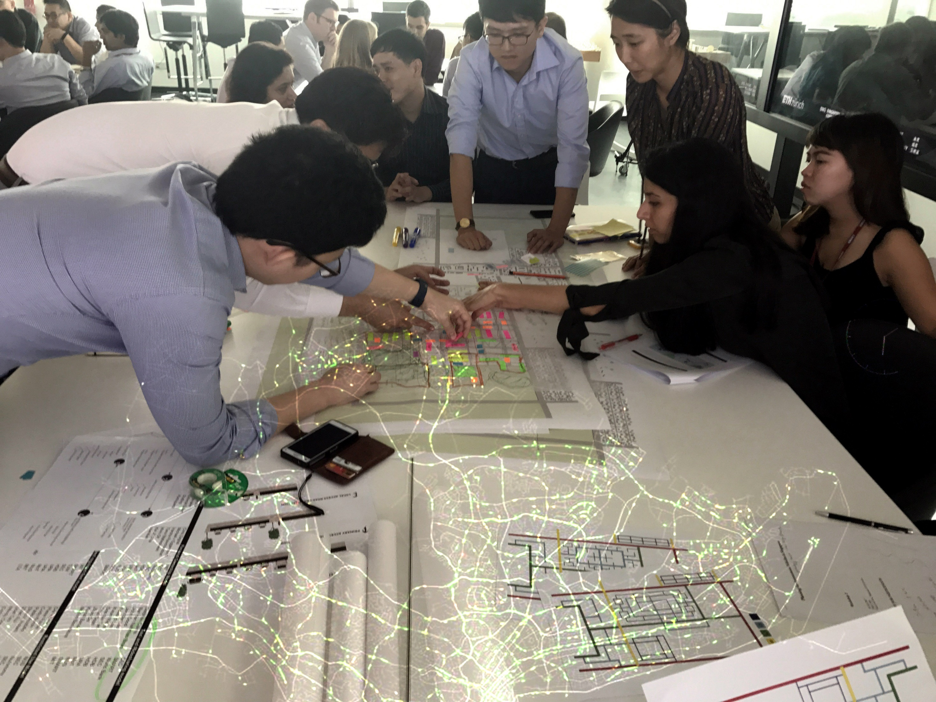
Notes:
Context and design need to work together with operational modes. Transport flows – friction, viscosity, volume speed to be considered during the design and planning process and not as an afterthought.

Slide 20
Principles of ‘Good Urban Form’ for Future Transport Flows in Singapore
1. Space efficiency
Changes in transport flows should facilitate more compact urban form and require less space per capita for transportation related infrastructure.
3. Social Cohesion
Transport flows should not rupture and divide communities, but connect them, in order to create social cohesion. Transport infrastructure should serve movement as well as place function.
5. Accessibility to Services
All users should be able to access transport flow networks.
6. Efficiency and Comfort
Friction in transport flows should be minimised for comfort of users and efficiency of movement.
2. Environmental Sustainability
Future transport flows and urban form should reduce use of resources through use of more efficient fuel and reducing need for travel as a whole, and encouraging active modes of travel.
4. Promote Active Lifestyle
Active modes of transport – like walking and cycling – promote urban vitality and public health. Therefore, these flows should be facilitated through urban design.
7. Adaptability
Urban form should be adaptable so that it is amenable to change in transportation flows in the future, as well change in lifestyle of users.

