Slide 1

Making Blockchain Real for Business and Government
Zelda Anthony, Head of Blockchain ASEAN, IBM Singapore

Slide 2


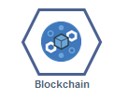
IBM Blockchain in a nutshell
Blockchain streamlines processes and establishes trust, accountability and transparency
Blockchain can reimagine the world's most fundamental business interactions cross industry and open the door to invent new styles of digital interactions.
Key drivers for companies and governments adopting Blockchain are to improve operational processes to reduce costs, improve transparency, speed up transactions, increase security reduce fraud, develop new business models and provide a better customer experience
IBM is working on adopting Blockchain for a very broad range of business applications and industry solutions and is working with numerous customers on POCs, pilots and scaling already live networks across different industries
Blockchain is a key focus of IBM’s strategy today, it reflects IBM’s history as a transaction provider

Slide 3

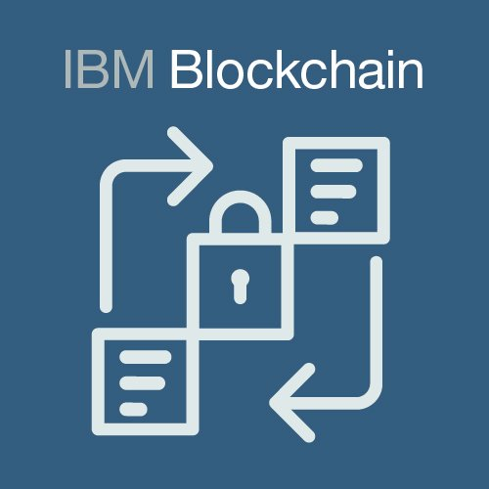






A shared, immutable ledger for recording the history of transactions
IBM Blockchain technology is:
Not like Bitcoin which is public and anonymous
A permissioned network with known identities
No Cryptocurrency involved unless required eg payments
Distributed and secure network
No mining consensus - No high energy usage, or slow transaction speeds
Consensus
Provenance
Finality
Immutability
Enables…
Multi-party, Federation of trust
Prevents/solves disputes
Automates processes, reduces paper
Real-time collaboration within and across industries
Benefits…
Saves
Transaction time from days to near instantaneous
Lowers
Overheads and intermediary costs reduced
Global
Reduces
Tampering, fraud, disputes
Instantaneous global visibility
Time
Cost
Visibility
Risk
Efficiency improvements and also new business models

Slide 4











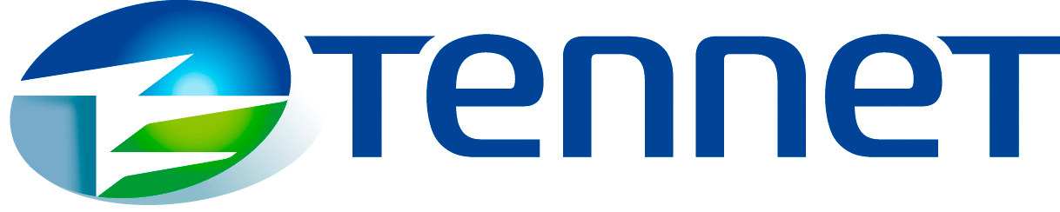
























IBM is making Blockchain real for business with diverse engagements delivered within enterprises and within and across industries
Trade Finance | Pre and Post Trade | Complex Risk Coverage | Commercial Real Estate
Identity/ Know your customer (KYC) | Unlisted Securities / Private Equity Funds | Loyalty Program Mgt. | Distributed Energy & Grid Mgt.
Medical Health Data Exchange | Anti-Fraud & Port Mgt. | Carbon Credit Mgt. | Asset Tracking
Supply Chain & Logistics | Food Safety | Audit | Digital Rights & Copyright Mgt.

Slide 5



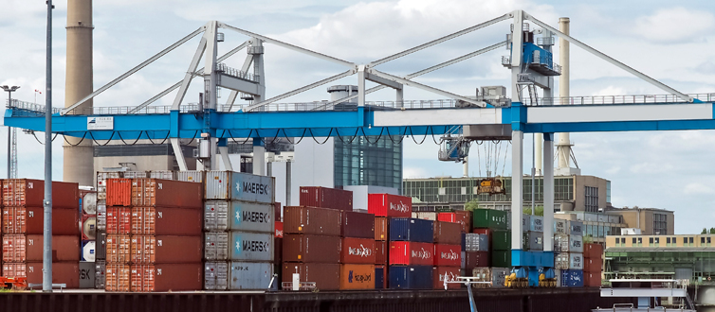






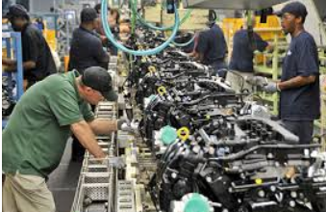








IBM Blockchain Projects – Cross Industry Real Network Examples
Digitalization of Shipping
Valuable Asset Traceability
Food Safety
Manage and track the paper trail of tens of millions of shipping containers across the world by digitizing the supply chain process
Track diamonds from mine to retail. Include digital certificate. Use crypto-anchors to determine properties and ensure not counterfeit.
Hold the history of food items through the entire supply chain providing traceability of food from “farm to fork”
IBM GTD
Provenance
IBM Food Trust
Manufacturing Provenance
Trade Finance and LOG
Reduce Invoice Disputes
Hold complete provenance details of each component part, accessible by each manufacturer in the production process
Simplify and facilitate domestic and cross-border trade while helping to increase overall trade transaction transparency. Letter of Guarantee issuance
Create a consolidated and detailed view of transactions visible to all parties resulting in a reduction in # disputes, dispute cycle time, and improvement in productive use of working capital.
IBM SC Ledger
IBM GF
Blockchain project examples beyong POC/pilot

Slide 6
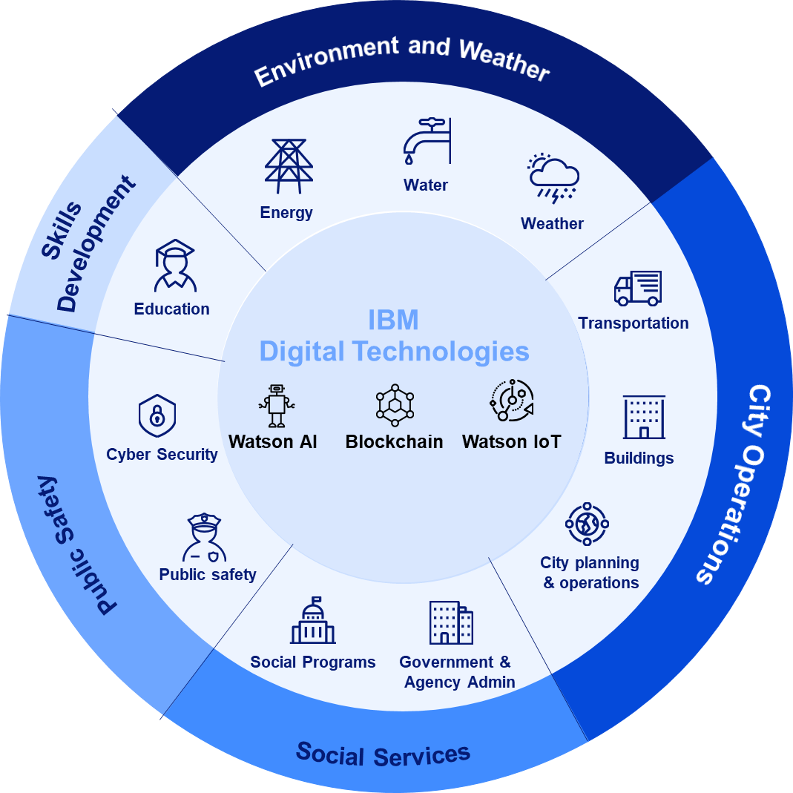
Global Blockchain Government Example Discussions/projects
Registries
Birth
Voter
Corporate
Land/housing
Vehilcle licences
Electric bikes
Firearms
Supply chain
Pharmaceutical
Food
Energy
Customs
Payments
CBDC
Social benefits
Grants management
Tax payments
Identity
Self sovereign identity
Document verification
Corporate KYC
Health records
Trade Finance
E-invoicing
Cross border trade finance
Education
360 Student/student lockers
Dubai Government inspiration: The World’s first Blockchain-powered government by 2020
1.5 billion in savings per year - a paperless government

Slide 7

Blockchain - Enabling citizens to build an accurate, complete, record of life
Parents register birth
First holiday overseas
Start lifelong educational journey
First usage of social media
Register for bank account
Get first of many jobs
Purchase first house with mortgage
Move to another country
Citizen Blockchain Record
Birth Travel Education Social Media Bank Employment Buy House Relocate
Government registrar records birth as first blockchain record and issues electronic birth certificate
Passport issued in physical & digital format. Blockchain record updated
Attainment certificates at every level authenticated by provider and added to the blockchain
Digital identity used to register with social media provider
Digital identity used by bank and account details appended to blockchain identity
Citizen opens up education certificates to employer. Job details added to the blockchain
Government registers asset ownership change, associates with blockchain identity
Citizen opens up parts of blockchain identity to new government.
New location added to chain. Streamlined registration for new services
Permissioned access, data private, access can be controlled by the citizen
Notes:
So imagine a world where we each have our own identity chain. As we add data points to our chain, the level of trust increases that we are who we say we are. This increasing measure of trust is fundamental to the concept of a digital identity and one which will ultimately deliver our vision of a single holistic identity that is controlled by the citizen themselves. We can perhaps assign a trust score to each citizens chain to enable identity consumers to determine whether additional information would be required to deliver the service being requested.

Slide 8
Emerging Economies: Blockchain for Social Impact examples
Financial inclusion
World Wire
- P2P X border payments
Twigga foods
- Microfinancing Kenyan
kiosk owners
Identity
Sovrin
- Self-sovereign digital ID
Environment
Energy Labs
- Carbon asset management
Plastic Bank
- Sustainable plastics
Health
FDA
- Health records
Pharma supply chain
- Avoid counterfeit medication
SME trade finance
we.trade
- Facilitate cross border trade
Food safety
IBM Food Trust
- Facilitate small Growers
Public records
Kenyan Government
- Real estate, health, education
“In emerging markets, the lack or immaturity of certain essential public services could allow
governments to leapfrog ahead to help policymakers achieve their aims”
E&Y – How Blockchain can help create better public services

Slide 9




Finally…Government’s Role in Enabling Blockchain Projects
Own projects
Facilitating collaboration
Regulation / policy reviewer
Educator
Providing efficiencies for the government and an enhanced citizen experience | Facilitating collaboration across ecosystem(s) within and across industries | To review, and if needed update, regulation and policies impacting the use case | Educating different levels of government, private sector and citizens

