Slide 1
Empowering
Massive IoT
1st IoT Dedicated Network Operator in Asia
Jonathan Tan
MD Singapore
Singapore 114 Lavender Street, #10-85, CT Hub 2 (Lift Lobby 1) Singapore 338729 | +65 63864932 Taiwan 7F, No 136, Section 1, Neihu District, Taipei, Taiwan | +886 2 2657 7123
Henri Bong
CEO

Slide 2
About UnaBiz
Unleash Massive IoT
Sigfox is the world’s leading provider of connectivity for the Internet of Things (IoT). The company has built a global network to connect billions of devices to the Internet while consuming as little energy as possible, as simply as possible. Sigfox’s unique approach to device-to-cloud communications addresses the three greatest barriers to global IoT adoption: cost, energy consumption, and global scalability.

Slide 3




























































































Thriving Ecosystem
Singapore Partners
Strategic Partners:
System Integrators:
Solution Providers:
Manufacturers:
Business Partners:
Institutions:
Telecommunications:
>70 Singapore Partner signed to date
Notes:
Other Partners: Flexi Systems, Soracom, Metro Parking, IoT Connect, Graphikee, CCP, Tcam, Simple Little, Omni Remote, Netlynx, Skygrid,

Slide 4
Changing The Game
50 billion connected devices. $19 trillion opportunity. All by 2020.

Slide 5





4 IoT
Common Usages
Sensors Report
Tracking
Event Report
Asset
Management
Regular Sensor
Measurement
Geolocation of
a Device
Alert, Alarm,
Button, Trigger
Actuators, Parameters
Settings

Slide 6

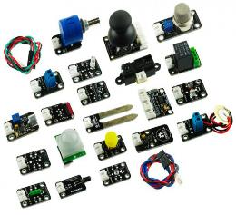




IoT
Architecture
Sensors
Network
Platform
Applications
Integration to Enterprise Systems
AI
Analytics
Machine Learning
Blockchain
AR/VR
“ IoT is not just a market but an entire ecosystem.”
- Forbes.com

Slide 7
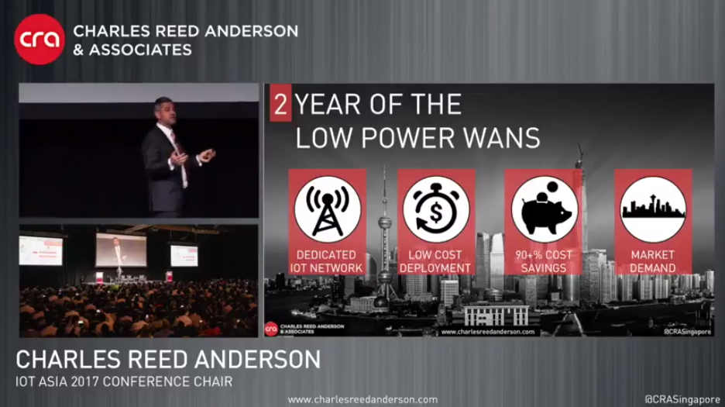
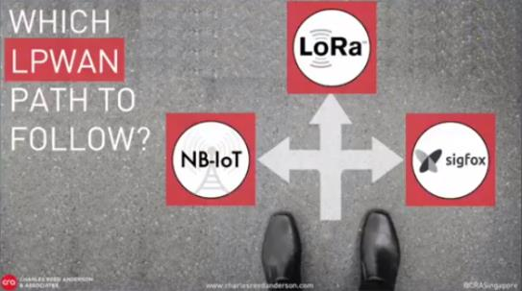
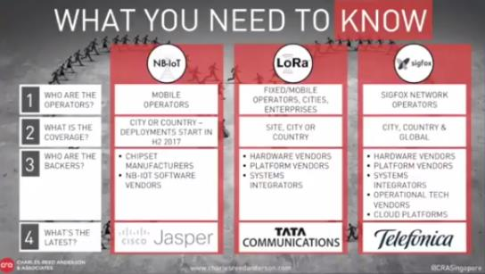
Rise of LPWANs
Low Power Wide Area Network
© Charles Reed Anderson & Associates

Slide 8





Sigfox
A Unique IoT Network
Energy Efficient
Global Reach
Simplicity
Low Cost
  Low power consumption
  45 Countries Coverage
  One contract Worldwide
  “Out-of-the-box” connectivity
  No gateway
  Low Device
  Low Annual Fees

Slide 9
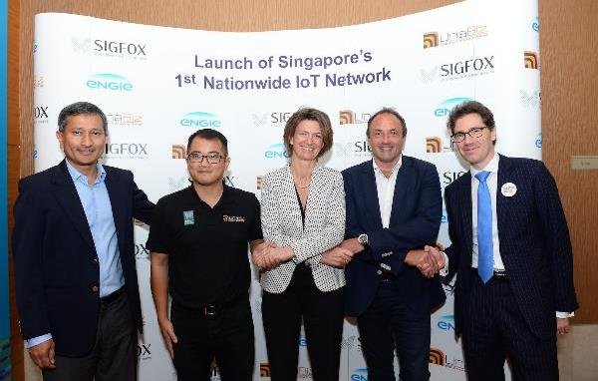
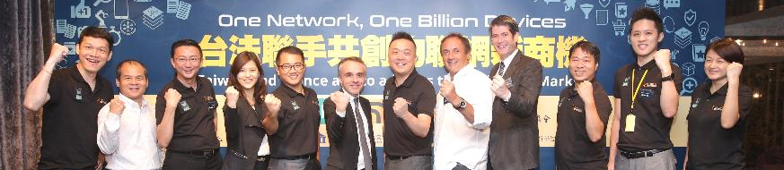
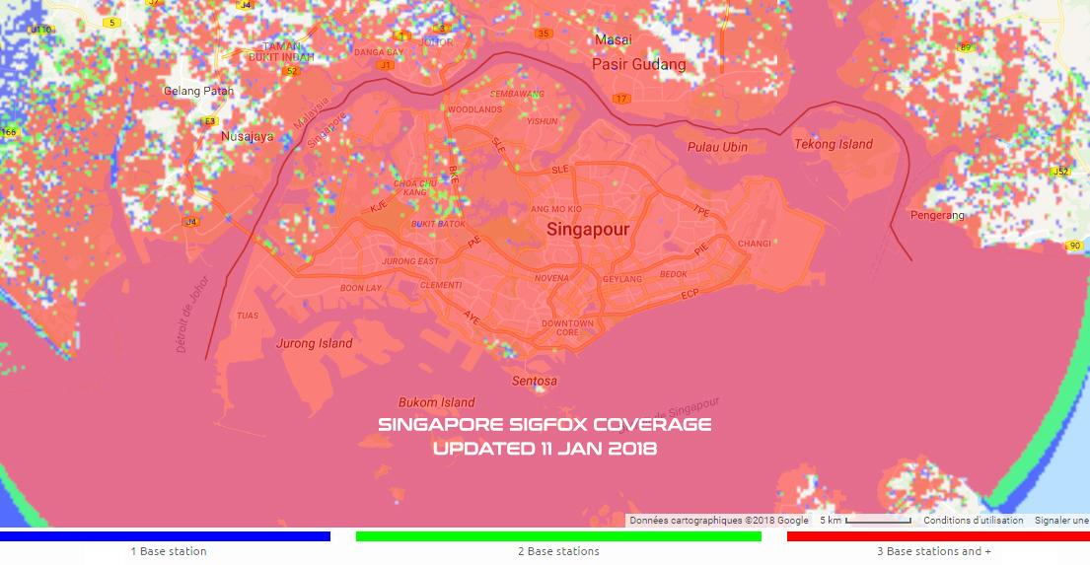
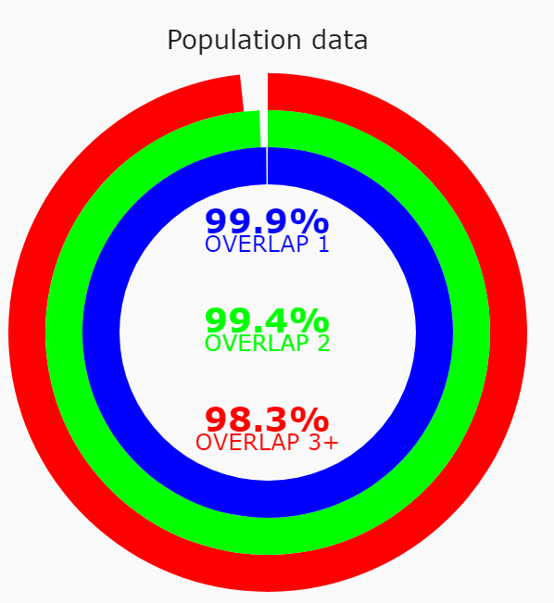
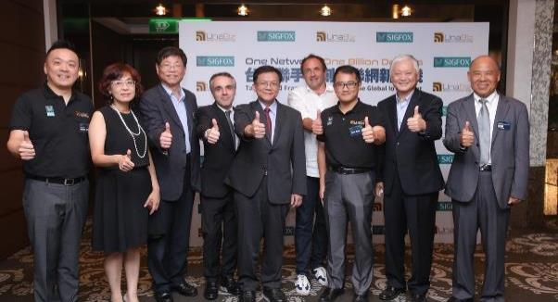
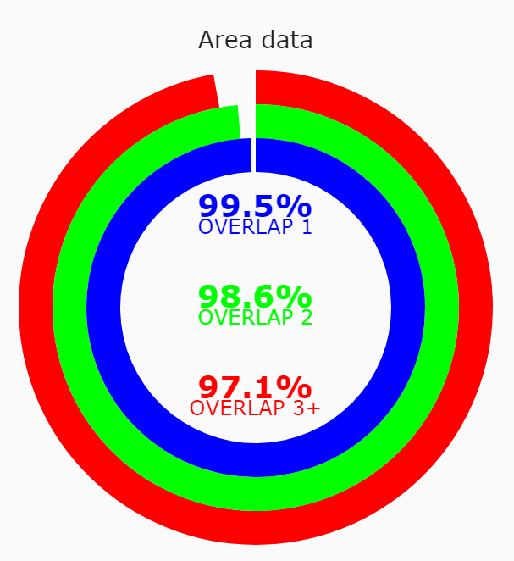
UnaBiz IoT
Network Operator
Solutions
Service
2 Offices (Singapore & Taipei)
Isabelle Kocher - CEO of ENGIE,
Minister of Smart Nation Initiative - Vivian Balakrishnan,
Benjamin Dubertret – French Ambassador
Singapore Launch on 11/07/2016
70++ Ecosystem Partners
300+ customers engagement
700+ Press / Media / Blogs speaking about UnaBiz
10,000+ followers from Industry worldwide
Chaney Ho – President – Advantech,
Y.C. Chang – Managing Director – ETC,
Pao-Chung Ho – EVP – III,
Benoit Guide – Ambassador,
Taiwan Launch on 01/08/2016

Slide 10
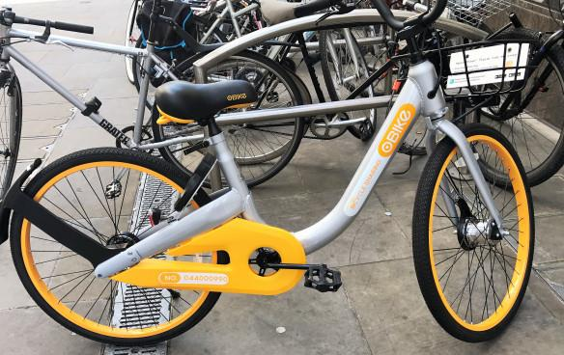

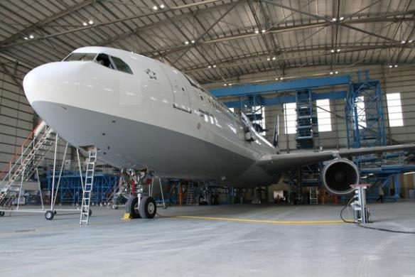



Use Cases
Geolocation tracking for bike-sharing service provider oBike.
Smart Hospital Initiative with ENGIE Services with temperature sensors to control and trigger alerts. Improve energy efficiency and operational efficiency.
Advance Research in Digitalisation of Aircraft MRO (Maintenance Repair and Overhaul) for global applications.

Slide 11


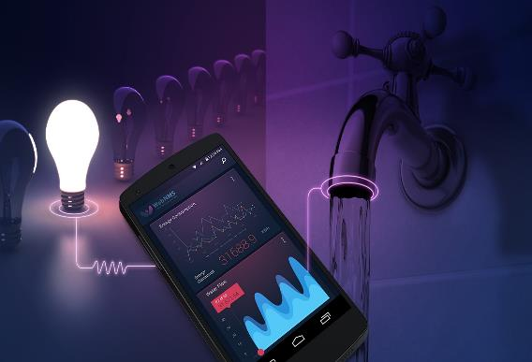
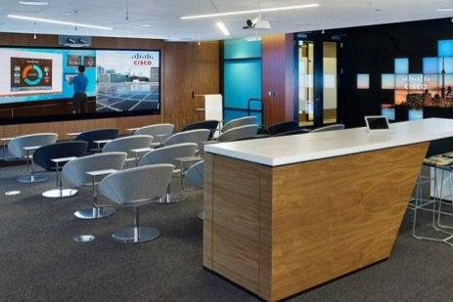
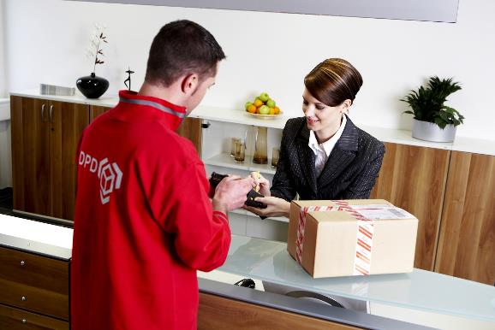


Use Cases
UnaBell
Smart Energy/Utilities for metering for electricity, gas and water consumption.
Smart Buildings for environmental sensors such as Light, Temperature, Motion, Air Quality, Toilets, Smart Locks, Smoke and Fire.
Smart Buttons for Product and Services
Restocking daily essentials, booking of taxis, ordering of courier

Slide 12
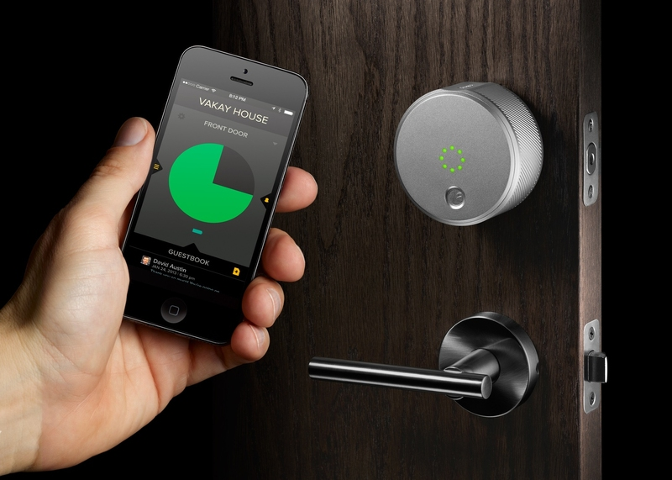

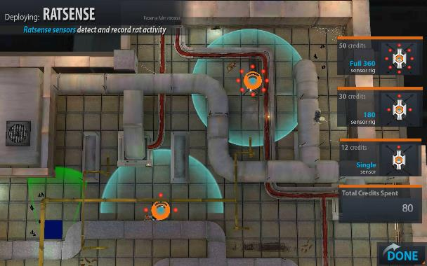
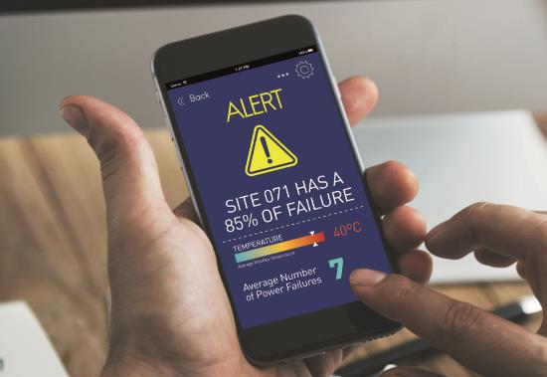
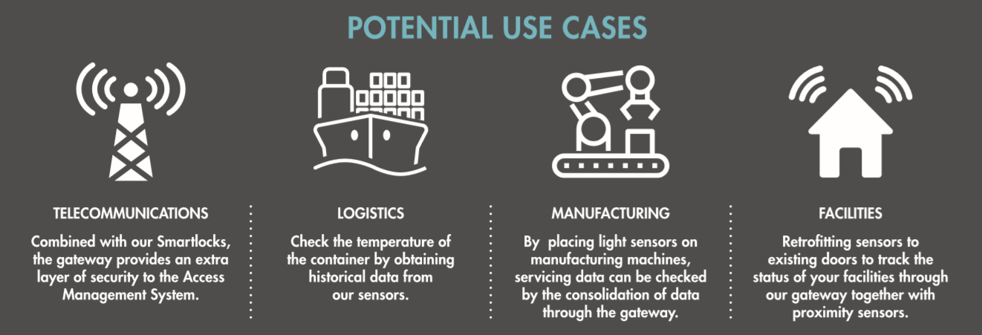
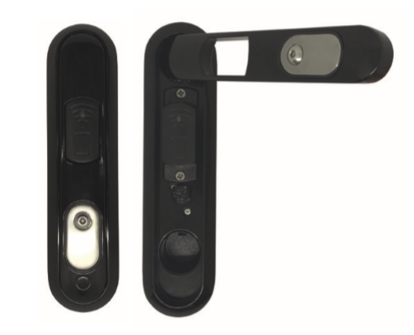
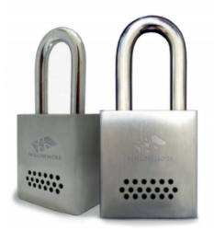



Use Cases
IoT Communication Platform for connected devices. Also offers network and API coordination for IoT system.
Integrated Rodent Monitoring System with Data Analytics.
Smart Access Control Management System with Smart Padlock, Cabinet Lock and IoT Gateway.

Slide 13


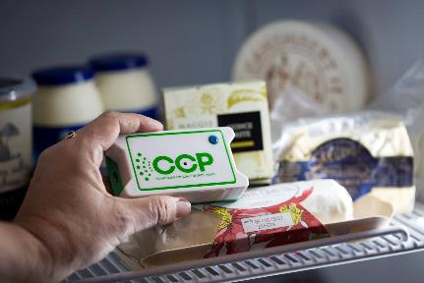
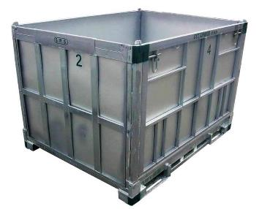


Use Cases
Construction/ Retail
Trackers for Workers Safety and Assets Tracking
Tracking devices for car, elderly, pets, with alert button
Critical Control Temperature Monitoring Solutions
Machine Sensors
Ultra low-cost worldwide tracking
Feedback Button, Customer Satisfaction

Slide 14

< = >
Minimalism
Less is More

Slide 15








Be our Ecosystem Partners
Free Connectivity + Training
Business Match-Making
Jonathan Tan https://www.linkedin.com/in/jontan1/
Jonathan.tan@UnaBiz.com
Access UnaDrive
Public: http://bit.ly/unadrive
The IoT Revolution is Here
Join Us ☺

Slide 16

Thank You

